Slide 1
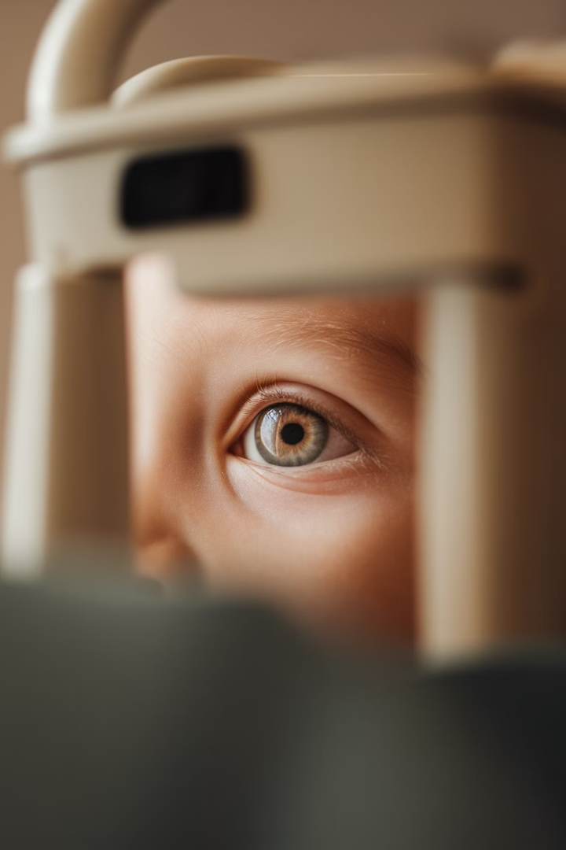
Retinoblastoma Detector:
Deep Learning-Based Eye Risk Assessment
By: Amir Navon, Adi Albeg, Taina Trahtenberg

Slide 2
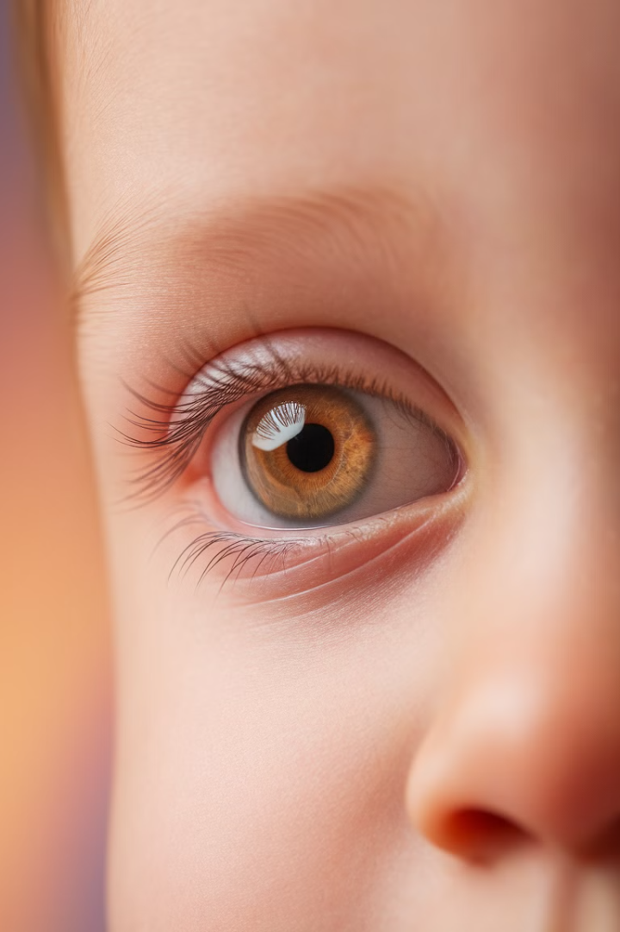
Retinoblastoma: A Childhood Eye Cancer
Retinoblastoma is a rare and aggressive type of eye cancer that primarily affects young children.
It originates in the retina, the light-sensitive tissue at the back of the eye, and can quickly spread if not detected and treated early.

Slide 3
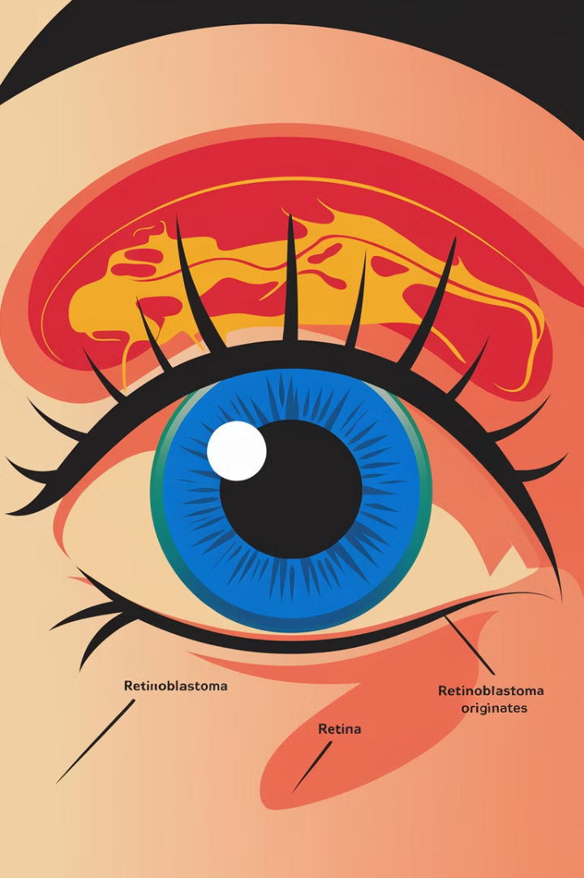

Understanding Retinoblastoma: What is it?
1
Genetic Mutation
2
Tumor Formation
Retinoblastoma is caused by a genetic mutation that leads to uncontrolled cell growth in the retina.
The mutated cells form a tumor that can quickly grow and spread to other parts of the eye and body.
3
Affecting Vision
As the tumor grows, it can damage the retina and optic nerve, leading to vision loss and other complications.

Slide 4
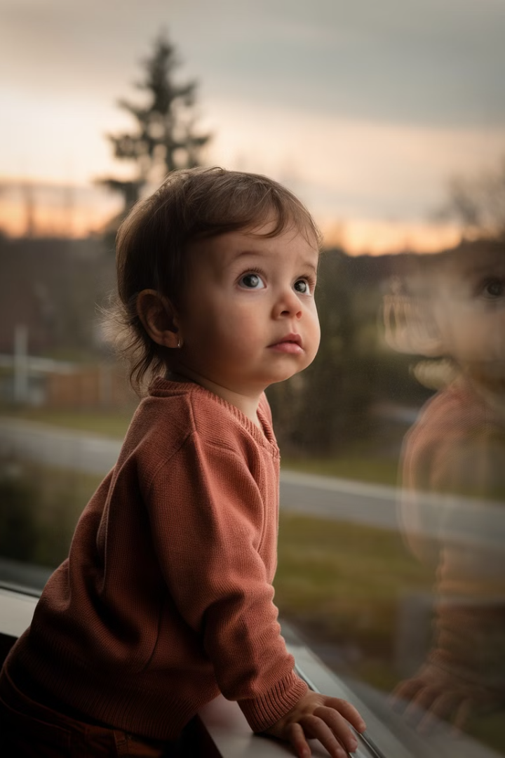
Potential Consequences of Late Detection
Vision Loss
Metastasis
If retinoblastoma is not detected and treated early, it can lead to permanent vision loss or even blindness in the affected eye.
Delayed diagnosis increases the risk of the cancer spreading to other parts of the body, making it much more difficult to treat.
Fatality
In the most severe cases, late detection of retinoblastoma can result in the child's death if the cancer is not successfully contained.

Slide 5
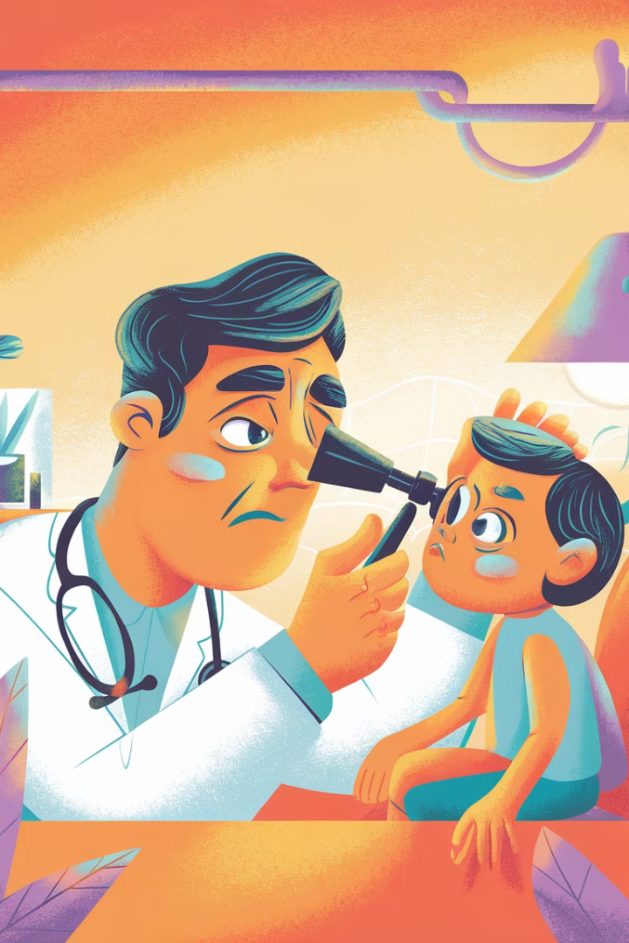
Early Detection Saves Lives
The Importance of Early Diagnosis:
With early detection and treatment, the survival rate for retinoblastoma can be as high as 95%.

Slide 6
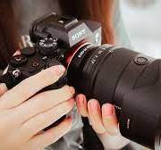
Project Objectives and Challenges
Early Detection
Accessibility
Create a system to identify retinoblastoma signs from everyday photos
Design for use with basic cameras or smartphones
Overcome Challenges
Address subtle visual features, variable input data, and accessibility needs

Slide 7
Dataset Preparation and Processing
Dataset Organization
Manually prepared dataset.
Images are categorized into two groups: healthy eyes and retinoblastoma-affected eyes.
Image Preprocessing
We use Mediapipe for eye detection in facial photos, crop the eye regions, and standardize all images to 224x224 pixels with normalized pixel values.
Augmentation Techniques
These techniques artificially expand the dataset size, reducing overfitting and improving generalization.
They include: Horizontal Flip, Random Rotation, Color Jitter, Random Resized Crop.

Slide 8




Model Architecture: Convolutional Neural Network
Pytorch implementation
Convolutional Layers
Extract meaningful features like edges, shapes, and textures
Pooling Layers
Reduce image representation size, focusing on important features
Fully Connected Layers
Combine extracted features to classify as Healthy or Retinoblastoma

Slide 9

Training and
Evaluation Process
1
Data Splitting
80% training, 20% validation
2
Optimization
Adam Optimizer adjusts model parameters
3
Training Loop
Training until the best model is found based on
validation lost
4
Evaluation
Confusion Matrix, Classification Report, ROC-AUC

Slide 10
Training and
Evaluation Results
Training Accuracy – 94%
Overall
Accuracy
94%
1
2
Validation Accuracy – 93%
3
ROC-AUC Score - 0.97
Confusion Matrix
 | No (0) | Yes (1)
No (0) | 15 | 1
Yes (1) | 1 | 14
4
The results suggest that the model performs well.
Indeed, 1 FN case ay require consideration for improvement

Slide 11
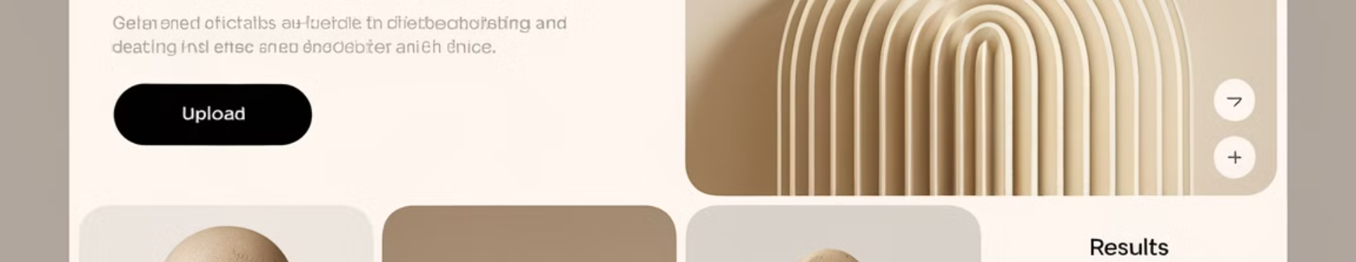




Deployment Using Streamlit
Upload Photo
Eye Detection
Classification
Display Results
User uploads eye or face photo
App detects and crops eye regions if needed
Each eye classified as Healthy or Retinoblastoma
Shows results with confidence scores

Slide 12
Why This Methodology?
Handling Variability
Specialized Image Analysis
PyTorch
Image preprocessing and Mediapipe manage variability in photo quality, ensuring consistent, high-quality data for the CNN.
Enables flexible debugging and real-time modifications during model development.
Speeds up training and inference, critical for convolution-heavy architectures.
Extensive libraries and support streamline implementation.
CNNs excel at recognizing subtle visual cues, making them ideal for identifying reflections in the pupil associated with retinoblastoma.
Accessibility
The use of everyday photos and a web app interface makes the tool accessible to a wide audience, potentially reaching more people in need.
GitHub
App

Slide 13
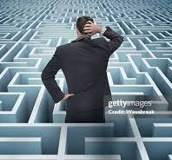
Our Group Challenges
Loss vs. Accuracy
trade-of
Limited Dataset
Larger data is desirable to improve the model's capabilities
Deciding what is more important for the specific model
Mediapipe and Streamlit Combination
MediaPipe operations can block the Streamlit app.
They might have conflicting dependencies.

Slide 14
Future Directions
Dataset Expansion
1
A larger dataset would improve the model's accuracy and generalizability
Advanced Augmentation
2
Implement techniques for better real-world robustness
3
Incorporate Pretrained Models
Use architectures like ResNet or EfficientNet
4
Mobile App Integration
Deploy model for use in remote areas
5
Batch Image Processing
Allow analysis of multiple images at once

